Slide 1




Student and Faculty Exchange Opportunities and Centre of Excellence in Social Sciences, Humanities, and Sciences
Prof. S. BALAKUMAR, FRSC, FInstP, FRSB, SMIEEE
Director, Research Schemes and Projects (RSP)
Institute Coordinator- GIANT Program, Govt of India
Laboratory for Sustainable Materials in Healthcare, Energy and Environment,
National Centre for Nanoscience and Nanotechnology
University of Madras
தேசிய அதிநுண்ம அறிவியல் மற்றும் அதிநுண்ம தொழில்நுட்ப மையம்
சென்னைப் பல்கலைக்கழகம்
சென்னை – 600025

Slide 2



Outline of the session
Outline of the session
Faculty/Student exchange Programs
Duties towards to Excellence
Strengthen our research programs by bringing more major projects
Students Exchange Program
Faculty Exchange Program
Centre of Excellence Avenues
Overseas Postdoctoral Platforms
Our Duties towards Excellence

Slide 3
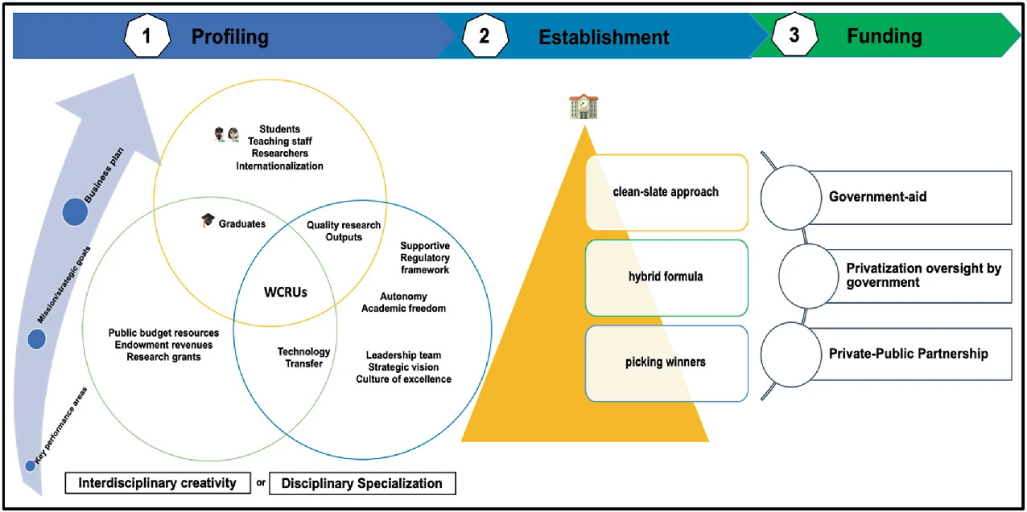
Road-map for establishment of world-class research universities
Sodedji, F.A.K., Assogbadjo, A.E., Osiru, M. (2025). Centres of Excellence for Research Development. In: Teferra, D. (eds) Research and Innovation in African Higher Education. Palgrave Macmillan, Cham. https://doi.org/10.1007/978-3-031-92909-0_6

Slide 4







Our Duties towards Excellence
Notes:
Teach & Inspire – Deliver high-quality teaching and mentoring, fostering curiosity and critical thinking. Encourage Mobility – Support student and faculty exchange programs to broaden exposure and collaboration. Research & Innovate – Undertake impactful research, publish, and contribute to interdisciplinary knowledge. Write & Secure Proposals – Actively pursue grants and funding to sustain research and innovation. Collaborate & Network – Build partnerships nationally and internationally through MoUs and formal networks. Mentor & Guide – Nurture students and junior faculty, fostering professional and personal growth. Uphold Ethics – Ensure integrity, transparency, and accountability in all academic and research activities.

Slide 5
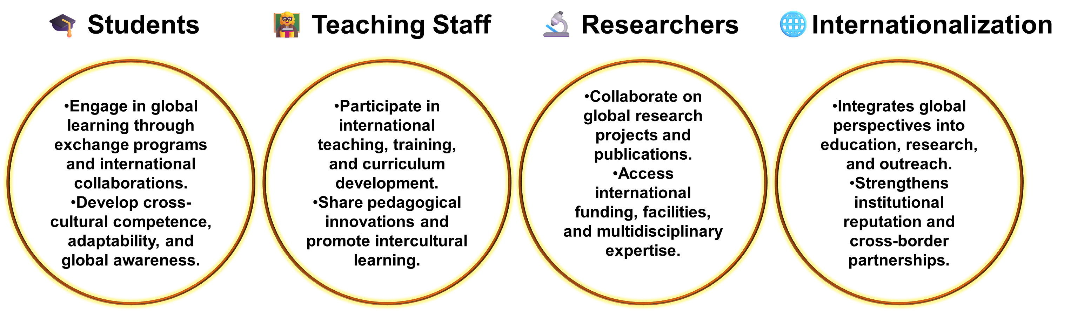


Profiling – Students and Teaching staff Researchers Internationalization
SKY IS THE LIMIT

Slide 6

Scholarships & Fellowships for Indian Students in Exchange Programs Abroad (2025–26)

Slide 7
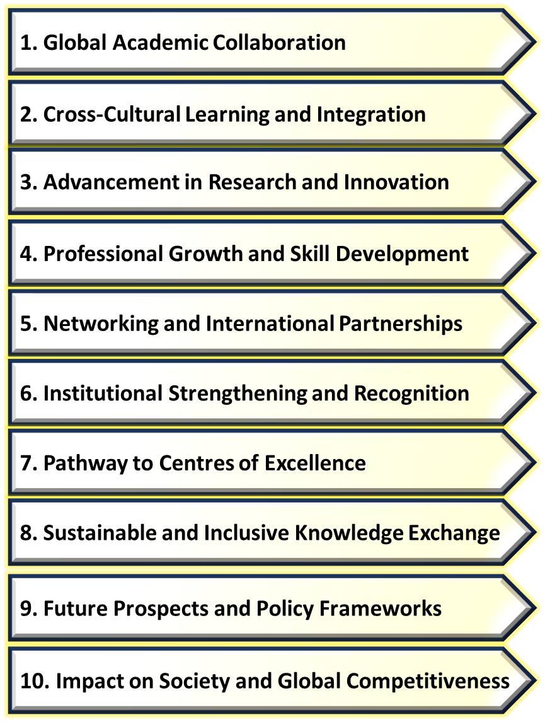

Why should we encourage Student Exchange Programs?
🌏 Global Learning: Study abroad at a partner university and explore new academic approaches.
🕒 Flexible Duration: Programs range from a few weeks to a full academic year.
🏠 Cultural Immersion: Live with a host family or in a dorm and experience local life.
Personal Growth: Learn a new language, gain independence, and build confidence.
International Connections: Make friends worldwide and develop a global perspective.
Notes:
https://amberstudent.com/blog/post/student-exchange-programme#different-types-of-student-exchange-programs

Slide 8
Different types of Student Exchange Programs
Academic Exchange: Study abroad at a partner university for a semester.
Research Exchange: Gain hands-on experience in international labs and projects.
Summer Exchange: Short-term summer programs for cultural and academic exposure.
Cultural & Language Exchange: Live with host families, learn traditions, and new languages.
Government-Sponsored Programs: Funded programs promoting global collaboration and cultural understanding.

Slide 9
Top 10 Student Exchange Programs
TEEP Exchange Program
MEXT - JAPAN
Erasmus Student Mobility Program
ISEP Exchange
Fulbright US Student Exchange Program
Global Graduate Exchange Program
INTERPOL Internships programs
DST- Overseas student Fellowship program

Slide 10
Exchanges Programs in Taiwan for Ph.D and Master students (Fully Funded Programs)

Slide 11
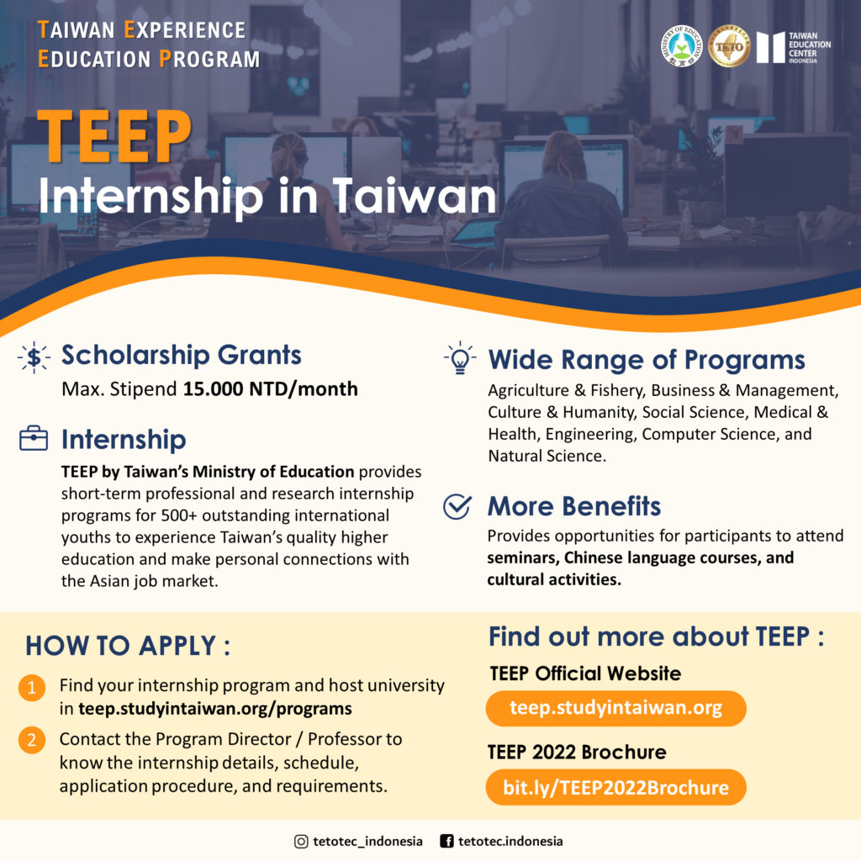
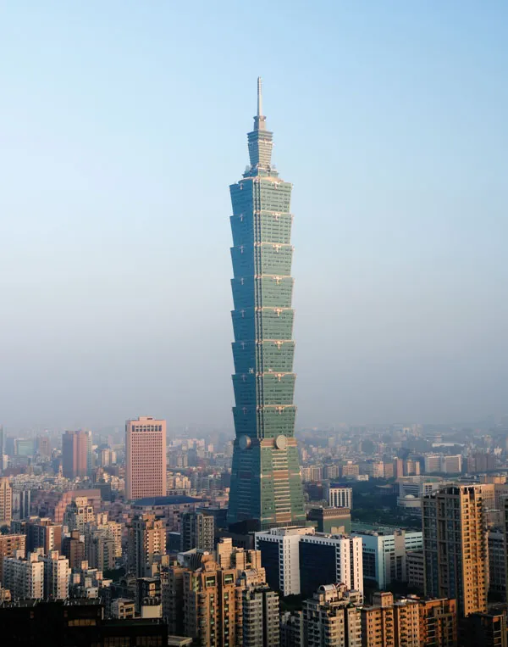


Slide 12
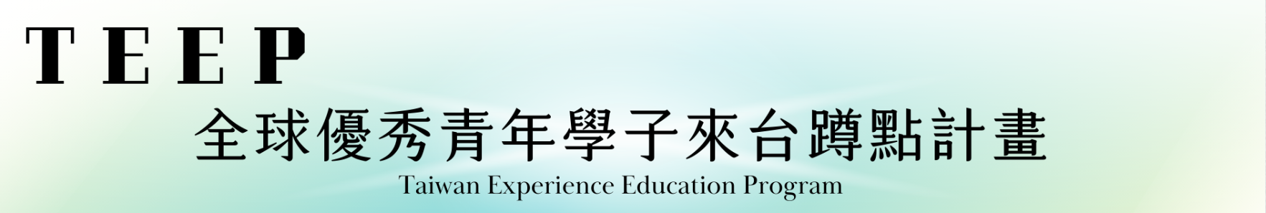
Program Introduction
Aims to attract international students for short-term study and internships in Taiwan, foster collaborative research with university faculty, and enhance the international visibility of Taiwan’s higher education.
Official Website: https://teep.studyintaiwan.org/
Funding Support Details:
Other expenses, such as airfare and accommodation, are not covered and must be paid by the student. If the participation period is less than one month, the scholarship will be prorated based on the number of days. The total monthly scholarship and administrative allowance per student shall not exceed NT$15,000. The maximum funding period per student is generally six months (180 days).
Eligibility:
Overseas Chinese youth with at least a high school diploma; doctoral degree holders are ineligible.
Not eligible for those who have studied or researched in Taiwan before, including exchange students or degree students.
Must enter Taiwan for TEEP; foreign spouses or workers already in Taiwan are ineligible.

Slide 13
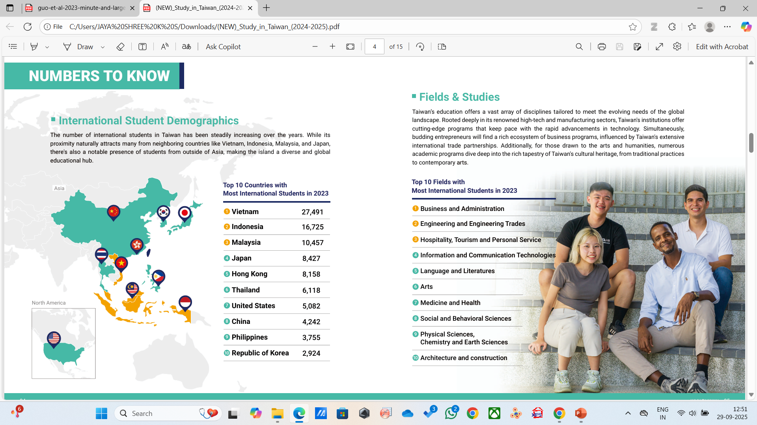

Slide 14
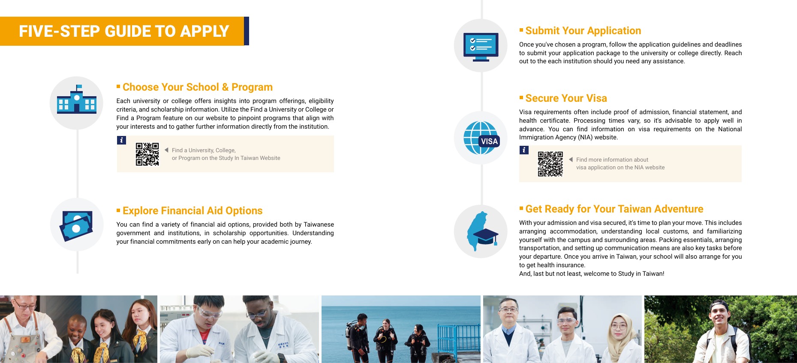


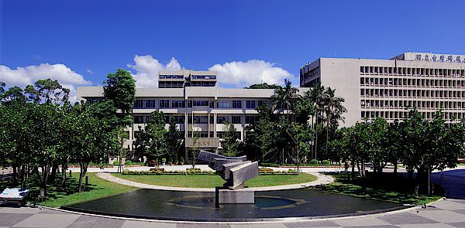
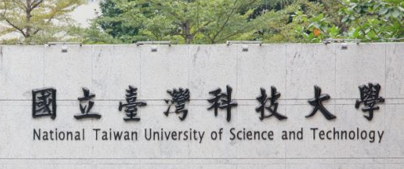

Slide 15
✨ Here’s how to apply: 1️⃣ Visit the official website and search for a program in your field of interest (e.g., Deep Learning, AI, Biotech, etc.): 👉 https://teep.studyintaiwan.org/programs
2️⃣ Each TEEP program is independently managed by its host university. That means the timeline, curriculum, and application process vary — be sure to contact the program directly via email or phone for detailed information.
3️⃣ Before reaching out, check the FAQ page for common questions: 👉 https://teep.studyintaiwan.org/faq
🕒 Internship Duration: 2 to 6 months 📅 Applications for current programs are still open! (Programs for 2026 will be announced around January 2026)
👩‍🎓Eligibility for TEEP Participation and Scholarship: According to the regulations of the Ministry of Education (MOE), applicants eligible for the TEEP scholarship must meet all of the following criteria:
Hold at least a high school diploma or above (PhD holders are not eligible).
Not currently studying in Taiwan (including as a degree-seeking or exchange student).
Hold a nationality other than the Republic of China (Taiwan) or the People’s Republic of China (including Hong Kong and Macau).
📌 Applicants who do not meet the scholarship criteria may still participate in TEEP programs at their own expense, provided they receive approval from the program chief.

Slide 16
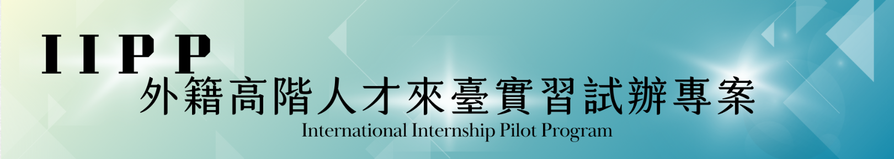
This program is an initiative by the National Science and Technology Council (NSTC) to provide high-quality internship opportunities in Taiwan for emerging global research talent. It offers students the chance to experience Taiwan's cutting-edge research environment, gain deeper insights into the nation's scientific capabilities, and potentially pursue further studies or careers in Taiwan, injecting new momentum into the country's R&D development.
Official Website： https://iipp.tw/
Program Details
Application Process: Professors and international students can register and apply separately via the IIPP official website.
Internship Duration: Minimum of 28 days, maximum of 90 days.
Funding: Up to NTD 30,000 per month for students not residing in Taiwan.
Requirement: A final report must be submitted upon completion.

Slide 17
UMAP Taiwan Exchange Student Scholarship
Purpose The UMAP Taiwan Exchange Student Scholarship Program, funded by the UMAP Taiwan National Secretariat (NS), has been established to encourage university student exchanges between UMAP member countries/territories and promote cultural and academic exchanges between Taiwan and other countries/territories to foster mutual understanding.
Scholarship Details
The UMAP Taiwan Exchange Student Scholarship Program is funded by the Ministry of Education, Taiwan.
Each exchange student will receive up to 20,000 New Taiwan Dollars (NTD) each month.
If an exchange program includes a period of less than a full month, then a corresponding proportion of the amount for a full month will be paid for that period.
The number of scholarships available will vary from year to year based on the availability of funds from the annual budget.
Timeline
The duration of the exchange programs is between one and two semesters.
Students may apply twice each academic year. The application deadline will be at the end of May and November, after UMAP IS finished with its placement (as shown in the timeline table below).
UMAP Taiwan NS will notify each student whose application to be an exchange student was successful via email.

Slide 18
Taiwan International Internship Program (1st May - 31st August):
The Taiwan International Internship Program is an intensive pre-doctoral research training program for overseas students that provides hands-on training and scientific experience at Academia Sinica and our partner universities.
Financial support:
NTD 30,000/month stipend (before tax) and half of the cheapest route round-trip airfare of an economy class from the intern's hometown to Taipei.
Note: If the interns are from the same location in the same batch, the reimbursement will be based on the lowest price (Max. NTD 15,000).
On-campus accommodation will be arranged with affordable price.
Opportunity to acquire scientific education, receive hands-on training, and learn the Chinese language.
Eligibility:
Undergraduate students in their final year
Master Students
Individuals holding a B.S. or Master's degree
Note: The followings are not eligible for the TIIP program:
Students pursuing a Ph.D. degree program.
Students/ Individuals who have attended the TIIP program before.
The current employees or research assistants at Academia Sinica.
Application opens from 15th Dec. – 15th Jan.
Internship Duration: 2 months
1st cohort: 1st May - 30th Jun.
2nd cohort: 1st Jun. - 31st Jul.
3rd cohort: 1st Jul. - 31st Aug.
For more information, please refer to TIIP Website: https://tiip.dia.sinica.edu.tw/
Contact email: tiip@gate.sinica.edu.tw

Slide 19


DAAD Scholarship Programmes

Slide 20
SMALL IMMEDIATE NEED GRANTS
Small Immediate Need Grant by the Indo-German Science & Technology Centre for setting up a new collaboration with a German researcher.
https://www.igstc.org/home/sing Grant is made available to support seed/modest funding for proposals towards: Joint initiatives/ideas that have a scope to ignite and open avenues for long term connect/technology development/new areas of collaboration. Joint activity towards innovation, rapid prototyping, technology demonstration or industrial R&D. Individual proposals that have a high potential of involving industrial sectors. Utilizing scientific events to share intellectual thoughts/ideas that can explore avenues for bilateral cooperation. Support Up to ₹ 9 lakhs (€ 10000) per proposal. Who could apply Those working in industries, academic and research institutions. Members/participants in any of the IGSTC programs including workshops. EAR community from ongoing inter-institutional MoUs between India and Germany. Personnel from the industry with specific requirements in applied research, technology development and entrepreneurship. Age limit: below 55 years.

Slide 21
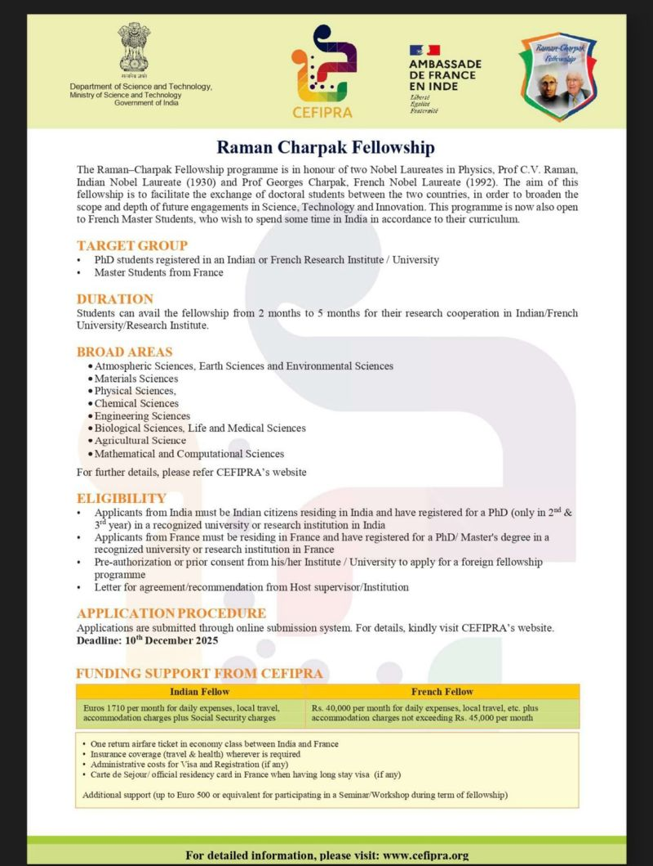

Slide 22
Exchange programs and funding
Fulbright Foreign Student Program: A U.S. government initiative that supports graduate students, young professionals, and artists from around the world to study and conduct research in the U.S.. The program is administered through binational Fulbright Commissions/Foundations or U.S. Embassies and can provide funding for up to a year of study.
Erasmus+: This program provides PhD students with funding to study and conduct research at top universities in Europe, covering tuition, travel, and living costs.
Institutional Partnerships: Many universities have direct partnerships with institutions globally for exchange programs. You can find these by checking the international relations or exchange programs office at your home institution.
Government and National Agency Programs:
In India, agencies like the UGC, ICSSR, SERB, and DST offer travel grants or funding for short-term research stays abroad in science, engineering, and other fields.
The DUO-India Fellowship Programme is another option for student exchanges between India and European countries.

Slide 23

Erasmus+ Mobility Program
Erasmus+
The Erasmus+ exchange program for Indian students helps organise student and doctoral candidate exchanges within countries fully part of the overall program. If you want to improve your communication, language and intercultural skills, then the Erasmus+ program is an excellent fit for you.
Category | Details
Eligibility | – Participants of the Erasmus+ project activities – Participating organisations, including informal groups of young people involved in an Erasmus+ project
Duration | 2 – 12 months
Application Timeline | Varies
Benefit of the Program | Exempt from fees for tuition, registration, examinations, and charges for access to laboratories or libraries
Who Should Apply | Higher education students at the short-cycle, bachelor’s, master’s, and doctoral levels

Slide 24
JENESYS
The Japan-East Asia Network of Exchange for Students and Youths (JENESYS) program aims to facilitate people-to-people exchanges between Japan and countries like India. As a part of this goal, the organisation introduces inbound programs for university/graduate students, young professional individuals, and passionate Japanese language learners.
Category | Details
Eligibility | – Must be a citizen of an ASEAN country or Timor-Leste (permanent residents may be considered). – Must have adequate English communication skills to engage in discussions and activities. – Age requirement: 18–35 years (15–18 for high school students; supervisors under 40). – Studied or worked with the Japanese language, culture, or business for over a year.
Duration | November 26 to December 3, 2025 (Subject to Change)
Application Timeline | Varies
Benefit of the Program | Promote mutual trust and understanding among the peoples of Japan and the Asia-Pacific region
Who Should Apply | Young professionals who have an interest in Japan

Slide 25
DAAD
The DAAD program under the German Academic Exchange Service allows you to study and research in Germany across higher educational institutions. Currently, it is also considered the world’s largest funding organisation for the international exchange of students and researchers. Anyone wanting to study in the top German universities can easily enrol in this exchange program.
Category | Details
Eligibility | – Possess a recognised school-leaving certificate. – Certificates from EU/EEA countries or Switzerland usually qualify directly.Non-EU students may need to complete 2–3 semesters of higher study in their home country or attend a Studienkolleg (preparatory course) in Germany. – The Feststellungsprüfung (assessment test) after Studienkolleg grants eligibility for university admission. – Check recognition of your certificate through DAAD’s My GUIDE or Anabin databases.
Duration | Varies
Application Timeline | Varies
Benefit of the Program | Research allowance, family benefits, or funds for language courses
Who Should Apply | Graduates, doctoral students and postdocs
Official Link | Click to Apply

Slide 26
Scholarships & Fellowships for Indian Students in Exchange Programs Abroad (2025–26) - UNDERGRADUATES
Program | Eligibility | Stipend / Coverage | Duration | Application Period | Link / Source
Global UGRAD Program (USA) | Indian undergraduate students | Tuition, travel, health insurance, living stipend | One semester | Varies by region; check official site | Global UGRAD
ISEP Exchange Program | Indian students from participating universities | Tuition, housing, meals, orientation, student services | One semester / academic year | Varies by home institution | ISEP Exchange
EdOdyssey Scholarships (Peru & Japan) | Indian students applying for EdOdyssey semester programs | Up to $2,000 | One semester | Check EdOdyssey website | EdOdyssey Scholarships
MEXT Scholarship (Japan) | Indian students pursuing undergraduate studies in Japan | Full tuition, monthly stipend, airfare | 4–5 years | Application deadlines vary; check MEXT website | MEXT Scholarship
DAAD EPOS MIDE (Germany) | Indian students with 2 years of work experience in development-related fields | Full tuition, travel, insurance, stipend | 2 years | Application deadline: 31 Aug 2025 | DAAD EPOS MIDE
Fulbright-Nehru Fellowship (USA) | Indian students pursuing master's or PhD | Tuition, travel, living stipend, health insurance | 1–2 years | Application deadline: 15 Sep 2025 | Fulbright-Nehru Fellowship
Commonwealth PhD Scholarship (UK) | Indian students from low-income backgrounds | Full tuition, airfare, living stipend | 3–4 years | Application deadline: 5 Oct 2025 | Commonwealth PhD Scholarship
Azim Premji Foundation Scholarship | Female students in India pursuing higher education | ₹3–6 lakhs to cover tuition fees | Varies; typically 1–2 years | Ongoing; check Azim Premji Foundation website | Azim Premji Foundation Scholarship

Slide 27

Scholarships & Fellowships for Indian Students in Exchange Programs Abroad (2025–26) – MASTER DEGREE GRADUATES

Slide 28
Scholarships & Fellowships for Indian Students in Exchange Programs Abroad (2025–26) – MASTER DEGREE GRADUATES
Program | Eligibility | Stipend / Coverage | Duration | Application Period | Link / Source
Commonwealth Master's Scholarships (UK) | Indian students from low- and middle-income countries | Tuition, airfare, living allowance | 1 year | 2 Sep – 14 Oct 2025 | CSC UK
Knight-Hennessy Scholars (USA) | Graduates who earned their first degree in 2017 or later | Full tuition, stipend, fees, room & board | Up to 3 years | Deadline: 8 Oct 2025 | Stanford KHS
Rotary Global Grant Scholarships | Graduate students studying abroad in areas of focus | $30,000–$400,000 (varies by district) | 1–4 years | Varies by district; check with local Rotary club | Rotary Scholarships
AAUW International Fellowships (USA) | Women pursuing full-time graduate or postdoctoral study | $20,000 for Master's; $25,000 for Doctoral | 1 year (non-renewable) | 1 Aug – 30 Sep 2025 | AAUW Fellowships
DAAD EPOS MIDE (Germany) | Professionals with 2+ years of work experience in development-related fields | Tuition, travel, insurance, stipend | 2 years | 31 Aug 2025 | DAAD EPOS
Erasmus Mundus Joint Master Degrees (EU) | Students with a Bachelor's degree | Tuition, travel, monthly allowance, insurance | 1–2 years | Varies by program; check official site | Erasmus Mundus
Inlaks Shivdasani Foundation Scholarships | Indian students with exceptional academic records | Tuition, living expenses, travel | 1–2 years | 15 Mar 2025 | Inlaks Scholarships
Macquarie University Early Acceptance Scholarship (Australia) | Indian students enrolling in postgraduate coursework degrees | AUD $10,000 per year (covers ~25% of tuition fees) | Full course duration | Apply by 30 Jun 2025 | Macquarie University Scholarship
Azim Premji Foundation Scholarship (India) | Female students pursuing higher education | ₹3–6 lakhs to cover tuition fees | Varies; typically 1–2 years | Ongoing; check Azim Premji Foundation website | Azim Premji Foundation Scholarship

Slide 29

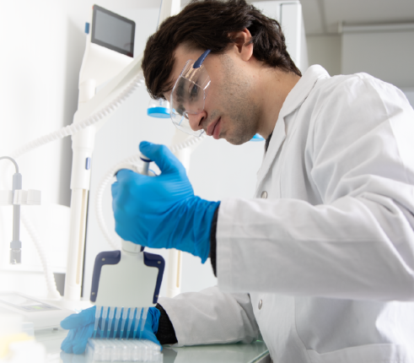

PhD Scholarships/ Fellowships

Slide 30
Scholarships & Fellowships for Indian PhD Scholars in Exchange Programs Abroad (2025–26) - Indian Government /India Based
Fellowship / Program | Eligibility | Duration | Stipend / Benefits | Notes
CSIR JRF / SRF | Indian nationals, MSc / MTech in relevant fields | 5-6 yrs (JRF → SRF) | JRF: ₹31,000/month; SRF: ₹35,000/month | Includes contingency grant, medical, and travel allowances
UGC NET Fellowship | Indian nationals, cleared NET, MSc / MTech | 5 yrs | ₹31,000/month | Can be upgraded to SRF based on progress
DST INSPIRE Fellowship | Meritorious BSc/BTech graduates joining PhD | 5 yrs | ₹35,000/month + ₹20,000/year contingency | Strongly supports research in natural sciences, engineering
DBT / ICMR / ICAR / DRDO Fellowships | Life sciences, biomedical, agricultural, defense research | 3-5 yrs | ₹31,000–₹35,000/month | Discipline-specific, may include project funding
Kothari Postgraduate Fellowship | Science & technology students | 5 yrs | Variable | Promotes high-end research training in India
Prime Minister’s Research Fellowship (PMRF) | IIT / IISc graduates joining PhD in India | 5 yrs | ₹70,000/month (year 1-2), ₹75,000 (year 3-5) + ₹2 lakh/year contingency | Prestigious, highly competitive
National Doctoral Fellowship (NDF) | Various Indian universities | 3-5 yrs | ₹31,000/month | Helps students in universities outside IITs/IISc
DST Overseas Doctoral Fellowship (ODF) | Indian students pursuing PhD abroad | Up to 4 yrs | Tuition + living allowance (varies) | Covers selected international universities
Raman-Charpak Fellowship | MSc students moving for PhD in France | 12–24 months | Travel + stipend | Exchange-focused, can lead to full PhD abroad

Slide 31
Scholarships & Fellowships for Indian PhD Scholars in Exchange Programs Abroad (2025–26) - International Exchange Part 1
Program | Eligibility | Stipend / Coverage | Duration | Application Period | Link / Source
Fulbright-Nehru Doctoral Research Fellowship (USA) | Indian PhD students | Tuition, travel, living stipend, health insurance | 6–9 months | 15 Jul – 15 Sep 2025 | Fulbright-Nehru
AAUW International Fellowships (USA) | Women pursuing full-time graduate or postdoctoral study | $25,000 for Doctoral | 1 year | 1 Aug – 30 Sep 2025 | AAUW Fellowships
Stanford Knight-Hennessy Scholars Program (USA) | Graduates who earned their first degree in 2017 or later | Full tuition, stipend, fees, room & board | Up to 3 years | 8 Oct 2025 | Stanford KHS
Rhodes Scholarships (India) | Indian students with exceptional academic records | Full tuition, living stipend, travel expenses | 2–3 years | 1 Aug – 30 Sep 2025 | Rhodes Scholarships
Gates Cambridge Scholarships (UK) | Outstanding applicants from countries outside the UK | Full tuition, living stipend, airfare | 1–3 years | 1 Dec 2025 | Gates Cambridge
Commonwealth PhD Scholarships (UK) | Indian students from low- and middle-income countries | Tuition, airfare, living allowance | 3–4 years | 2 Sep – 14 Oct 2025 | CSC UK
Marie Skłodowska-Curie Actions (MSCA) Doctoral Networks (EU) | Early-stage researchers with a Master's degree | Salary, research costs, mobility allowance | 3–4 years | Varies by project; check official site | MSCA Doctoral Networks

Slide 32
Scholarships & Fellowships for Indian PhD Scholars in Exchange Programs Abroad (2025–26) - International Exchange Part -2
Program | Eligibility | Stipend / Coverage | Duration | Application Period | Link / Source
DAAD Research Grants – Doctoral Programmes (Germany) | Indian students with a Master's degree | Monthly stipend, travel allowance, health insurance | 2–4 years | 31 Aug 2025 | DAAD Research Grants
Swiss Government Excellence Scholarships (Switzerland) | Indian students with a Master's degree | Monthly stipend, tuition fees, airfare | 12 months | 31 Oct 2025 | Swiss Government Scholarships
Research Training Program (RTP) (Australia) | Indian students pursuing a PhD at an Australian university | Tuition fees, living stipend, relocation allowance | 3–4 years | Varies by university; check official site | RTP Australia
Inlaks Shivdasani Foundation Scholarships (USA/UK/Europe) | Indian students with exceptional academic records | Tuition, living expenses, travel | 1 year | 15 Mar 2025 | Inlaks Scholarships
Taiwan Experience Education Program (TEEP) | Indian PhD students | Up to 15,000 NTD/month (stipend varies by program) | 2–6 months | Varies by institution; check official site | TEEP Taiwan
International Internship Pilot Program (IIPP) – Taiwan | Indian PhD students | Up to 1,000 NTD/day (approx. $30 USD) | 28–60 days | Varies by institution; check official site | IIPP Taiwan

Slide 33
International Post Doctoral Fellowships Abroad (2025–26)
Program | Eligibility | Stipend / Coverage | Duration | Application Period | Link / Source
Fulbright-Nehru Postdoctoral Research Fellowship (USA) | Indian Postdocs | Living stipend, travel, health insurance | 6–12 months | 15 Jul – 15 Sep 2025 | Fulbright-Nehru
Marie Skłodowska-Curie Actions (MSCA) Postdoctoral Fellowships, EU | Early-career researchers | Salary, mobility allowance, research costs | 1–2 years | Varies by call; check official site | MSCA Postdoc
DAAD Postdoctoral Research Fellowships (Germany) | Indian Postdocs with PhD | Monthly stipend (~€2,000), travel, insurance | 6–24 months | 31 Aug 2025 | DAAD Postdoc
Swiss Government Excellence Scholarships (Switzerland) | Indian PhDs / Postdocs | Monthly stipend (~CHF 2,500), tuition, travel | 12 months | 31 Oct 2025 | Swiss Government Scholarships
Inlaks Shivdasani Foundation Postdoc Fellowships | Indian Postdocs | Travel, living allowance, research expenses | 6–12 months | 15 Mar 2025 | Inlaks Foundation
Taiwan Experience Education Program (TEEP) – Postdoc | Indian Postdocs | Up to 15,000 NTD/month | 2–6 months | Varies by institution | TEEP Taiwan
International Internship Pilot Program (IIPP) – Taiwan (Postdoc) | Indian Postdocs | Up to 1,000 NTD/day (~$30 USD) | 28–60 days | Varies by institution | IIPP Taiwan
JSPS Postdoctoral Fellowship (Japan) | Indian PhDs | Monthly stipend (~¥362,000), travel, research allowance | 12–24 months | Apr / Oct 2025 | JSPS Fellowships
Alexander von Humboldt Postdoctoral Fellowship (Germany) | Indian Postdocs | Monthly stipend (~€2,700), travel allowance, research support | 6–24 months | Rolling; check site | AvH Fellowship

Slide 34
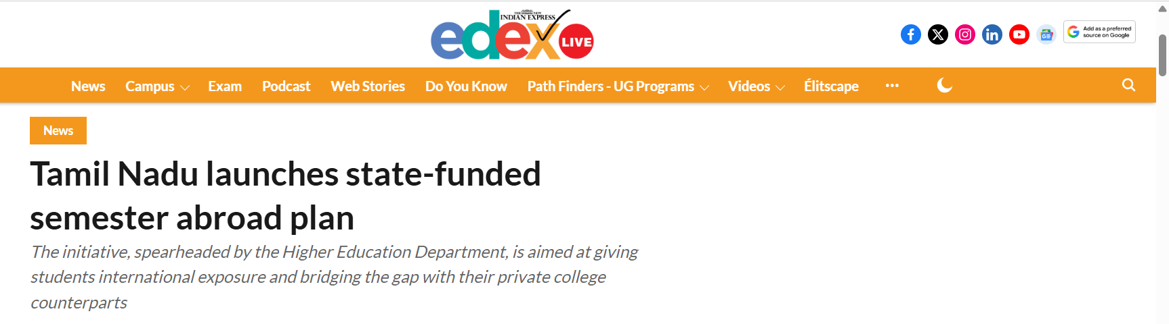
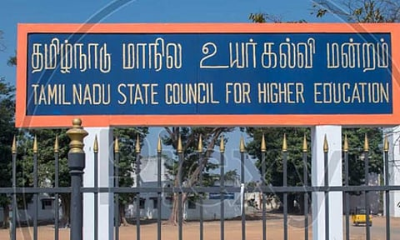
Government’s Recent Notable Act
Target Audience:
50 final-year students from government arts, science, and engineering colleges, with a focus on rural youth.
Fully Funded:
The state covers all expenses, including tuition, travel, and accommodation, ensuring accessibility for low-income students.
Expansion Plans:
The program will scale up based on demand, aiming to benefit more students in the future.
https://globaleducationnews.org/tamil-nadus-semester-abroad-program-empowering-rural-students-with-global-exposure/

Slide 35
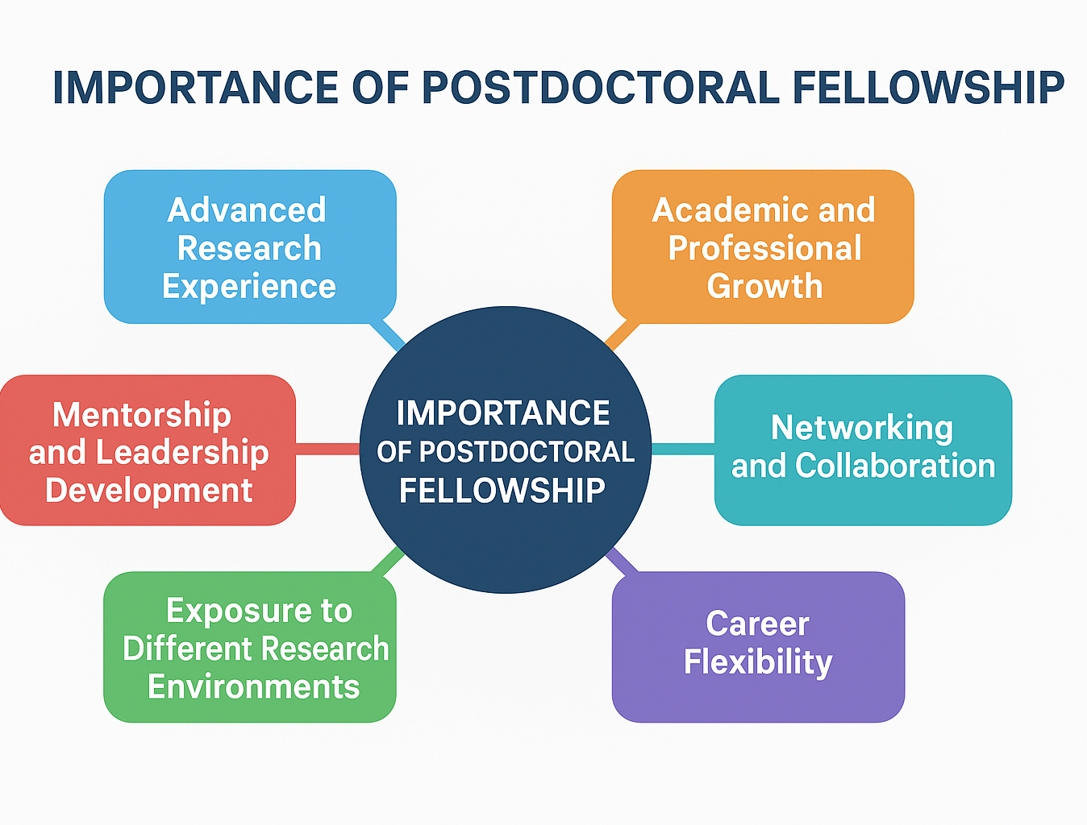
Postdoctoral Fellowships

Slide 36
Scholarships & Fellowships for Indian Postdoctoral Fellowships in Exchange Programs Abroad (2025–26)
Program | Eligibility | Stipend / Coverage | Duration | Application Period | Link / Source
DST INSPIRE Faculty / Postdoc Fellowship | Indian PhDs with recent graduation | ₹70,000–₹80,000/month + contingency | 2–3 years | Ongoing; check DST | DST Inspire
SERB Overseas Postdoctoral Fellowship (OPDF) | Indian citizens with PhD | Travel, research grant, ₹1–1.5 lakh/month | 6–24 months | 1 Apr – 30 Jun 2025 | SERB OPDF
Raman–Charpak Fellowship (Postdoc) | Indian Postdocs (recent PhD) | ₹1.25 lakh/month + airfare | 2–6 months | 10 Dec 2025 | Campus France
VAIBHAV Fellowship | Indian diaspora or Postdocs | Travel, accommodation, research support | Up to 2 months/year for 3 years | 15 Apr – 30 May 2025 | DST VAIBHAV
DST Science, Technology and Innovation Policy Fellowships Programme (STI-PFP) | Indian Postdocs and early career scientists | Fellowship amount varies | Varies; check DST | DST STI-PFP
National Postdoctoral Fellowship (NPDF) | Indian citizens with PhD or submitted thesis; age ≤ 35 years (relaxation for SC/ST/OBC/Women/PH) | ₹80,000/month (₹50,000 if thesis submitted but degree pending) + ₹2,00,000/yr research grant + ₹1,00,000/yr overhead to host | 2 years (extendable to 3 years) | Typically June annually | ANRF NPDF
Dr. D. S. Kothari Postdoctoral Fellowship (DSKPDF) | Indian PhDs in science; unemployed or on sabbatical; age ≤ 35 years (relaxation for SC/ST/OBC/Women/PH) | ₹43,800/month (1st year), ₹45,000 (2nd year), ₹46,500 (3rd year) + ₹1,00,000/yr contingency grant | Up to 3 years | Open year-round; must join within 6 months of award | UGC DSKPDF
Rajarshi Chhatrapati Shahu Maharaj Merit Scholarship | SC/Neo-Buddhist Postdocs from Maharashtra | Travel, living allowance, contingency | Up to 12 months | 30 Jun – 31 Oct 2025 | Rajarshi Shahu Maharaj Scheme

Slide 37

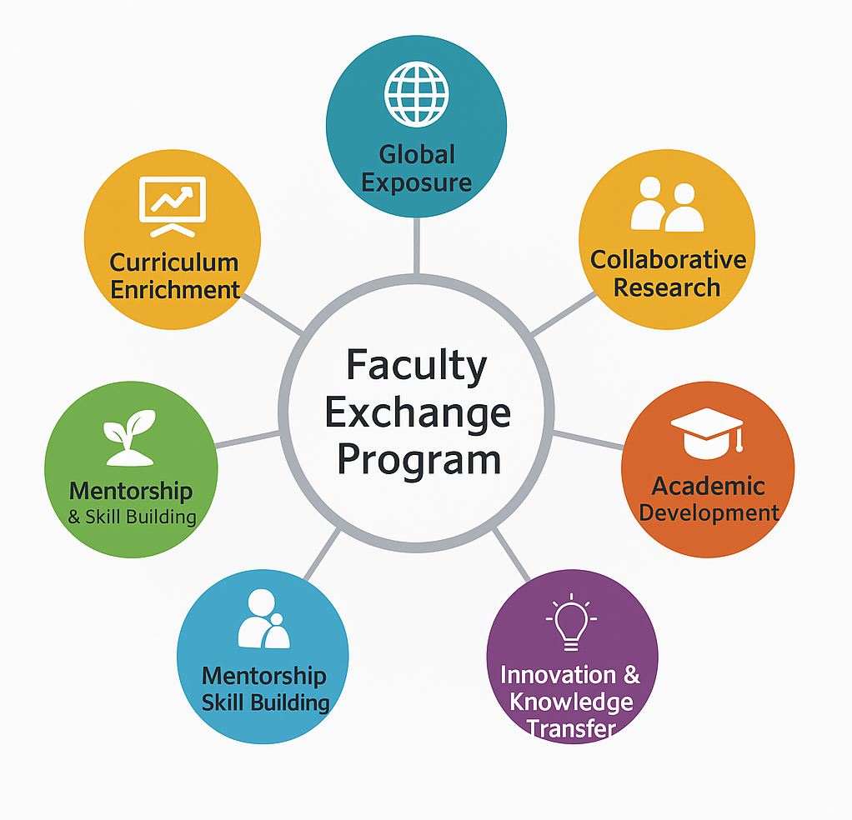
Faculty Exchange / Visiting Fellowships

Slide 38
Indian Faculty Exchange / Visiting Fellowships
Exchange Programs Abroad (2025–26)
Program | Eligibility | Benefits / Coverage | Duration | Application Period | Link / Source
VAIBHAV Faculty Fellowship | Indian faculty in academia or R&D | Travel, accommodation, research support | 2 months/year | 15 Apr – 30 May 2025 | DST VAIBHAV
Indian Technical and Economic Cooperation (ITEC) Faculty Programs | Indian faculty in recognized institutions | Travel, accommodation, living allowance, training | 2–4 weeks | Rolling; check embassy / MHRD | ITEC Programs
National Science & Engineering Research Board (SERB) Visiting Faculty Program | Faculty with PhD in science/engineering | Research grant, travel allowance, contingency | 1–6 months | Varies; annual call | SERB Faculty Programs
AICTE International Faculty Exchange Program | Faculty from AICTE-approved institutions | Travel, accommodation, stipend | 1–3 months | Rolling; check AICTE portal | AICTE Exchange

Slide 39
International Faculty Exchange / Visiting Fellowships
Exchange Programs Abroad (2025–26)
Program | Eligibility | Benefits / Coverage | Duration | Application Period | Link / Source
Fulbright-Nehru Academic & Professional Excellence (Faculty Exchange, USA) | Indian faculty with PhD | Travel, living allowance, health insurance | 3–6 months | 15 Jul – 15 Sep 2025 | Fulbright-Nehru
Commonwealth Academic Staff Fellowship (UK) | Faculty from Indian universities | Travel, living allowance, accommodation | 1–6 months | Varies; annual | Commonwealth Fellowships
Humboldt Research Fellowship for Experienced Researchers (Germany) | Faculty with PhD & significant research experience | Monthly stipend (~€3,150), travel, research funds | 6–24 months | Rolling | Humboldt Fellowship
DAAD Visiting Professorship / Research Grants (Germany) | Faculty or senior researchers | Travel, monthly stipend, accommodation, research support | 1–6 months | Varies; annual | DAAD Faculty Programs
Taiwan International Faculty Fellowship Programs (TEEP / IIPP) | Faculty from Indian institutions | Travel, accommodation, stipend (varies) | 1–6 months | Varies by institution | TEEP / IIPP
K.C. Mahindra Fellowships / INSA Visiting Scientists | Senior Indian faculty | Travel, accommodation, contingency | 1–3 months | Varies annually | INSA Visiting Scientists
Global Faculty Exchange Programs (Various Universities, e.g., USA/UK/Australia) | Indian faculty with PhD | Travel, accommodation, research support, stipend | 1–12 months | Varies by host institution | Check individual university portals

Slide 40
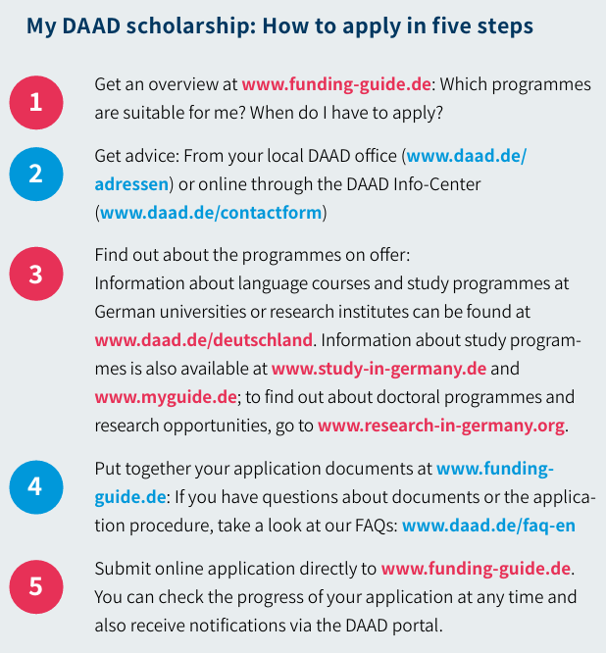
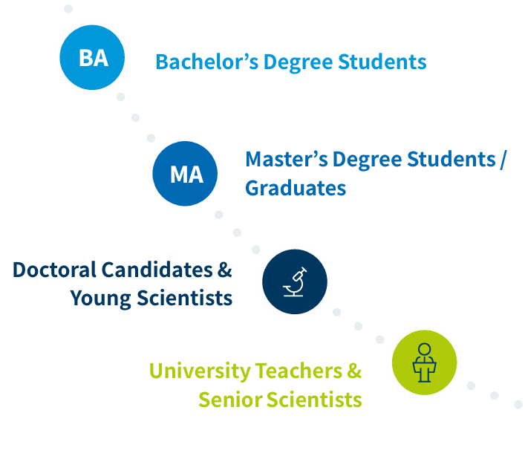
The Programmes are aimed at

Slide 41
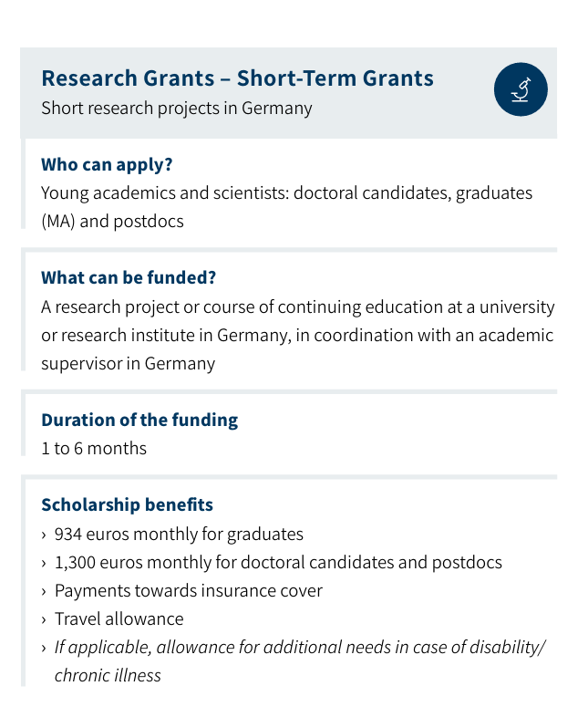
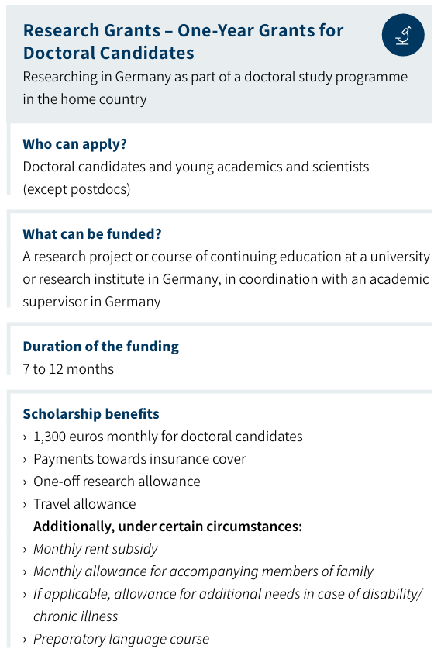
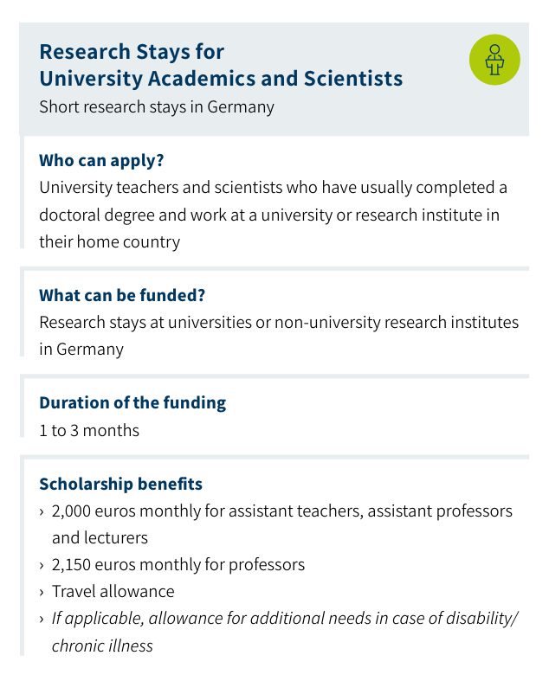
DAAD Grants
for Doctoral Candidates/Faculties

Slide 42
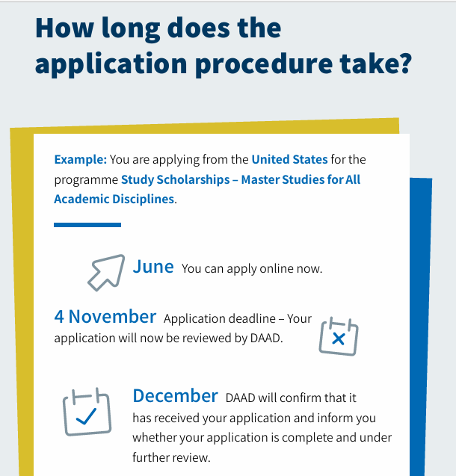
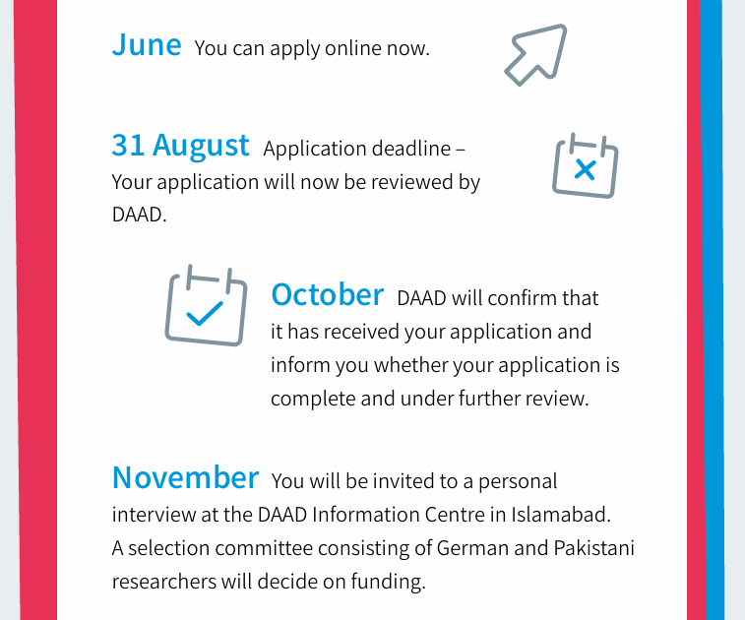
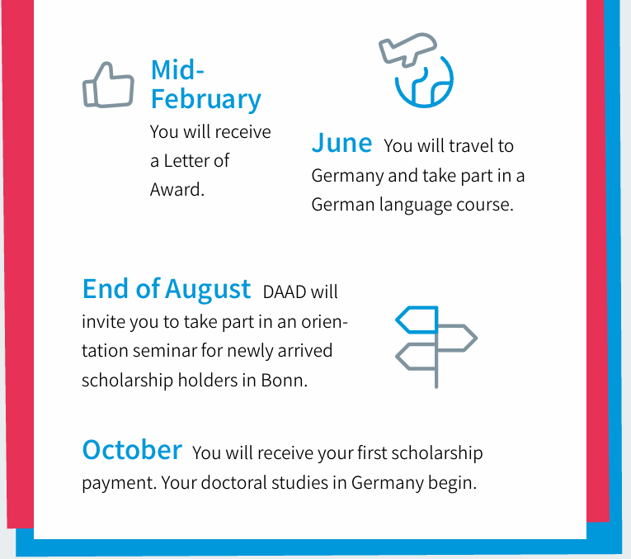

Slide 43
Faculty Exchange Programs

Slide 44
AICTE Industry Fellowship- For Faculties
All India Council for Technical Education (AICTE) Industry Fellowship Programme
An opportunity for faculty to collaborate with leading industry partners, gain hands-on exposure, and bridge the gap between academia and industry.
Open for faculty <45 years of age and >5 years of teaching experience who have qualified fellowship test (NET, GATE etc) or have >5 papers in indexed journals or have received project grants of >Rs 15 lakhs or have received young scientists award.
https://ifp.aicte.gov.in/faculty-registration

Slide 45
UN Young Women for Biosecurity Fellowship 2025
To commemorate the 50th anniversary of the Biological Weapons Convention, the United Nations Office for Disarmament Affairs in Geneva will hold a special iteration of the Youth for Biosecurity Fellowship Programme for 10 competitively selected young female scientists from the Global South.
Participants will join a series of online interactive webinars prior to a field visit during the Seventh meeting of the BWC Working Group on the Strengthening of the Convention in Geneva.
The Fellowship aims to support young women from the Global South active in the biosecurity field, providing an opportunity to learn, network and share perspectives on topics related to the BWC.

Slide 46
Queen Elizabeth Young Leader Awards
It is to recognize 100 inspirational Young Leaders from across the Commonwealth, to celebrate exceptional individuals from diverse regions, representing QECT’s five key focus areas: education and employability, environment, food and agriculture, health, and inclusion. Eligibility Age: 18 to 35 years old at the time of application (born between April 1990 and April 2008). Leadership Role: Must be the founder, co-founder, or in a key leadership position of a social impact initiative. Citizenship/Residency: Must be a citizen or permanent resident of at-least one of the 56 Commonwealth countries. Track Record: Demonstrate measurable community or global impact for a minimum of 12 months.
https://queenscommonwealthtrust.org/100yla/

Slide 47
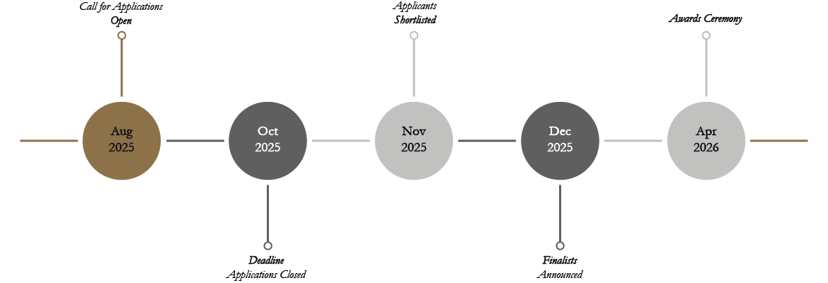

Slide 48


Slide 49
Brain Pool Fellowship Program
Funded by MSIT (Ministry of Science and ICT) and NRF, host researchers in South Korea who wish to invite outstanding scientists to join the Brain Pool(BP) Program.
The program is designed to invite overseas outstanding scientists to domestic research institutions in Korea, required by domestic industry, academia, and research sites, for the enhancement of research competence through joint research in R&D fields in Korea, in which he or she produces high level of R&D performance and to contribute to the internationalization of the domestic research environment,
Next expected application period: December 2025 or Early 2026

Slide 50
Duration and Fellowship Types :The Brain Pool Fellowship is structured into the following participation types:
Fellowship Type | Duration | Extension / Reapplication
Type 1 (Short-Term) | 6–12 months | One-time reapplication permitted
Type 2 (Long-Term) | Up to 3 years (2+1) | Third year based on interim evaluation
Additionally, the Brain Pool Plus (BP+) stream may support projects lasting up to 10 years (4+6). This format is specifically designed for major national research initiatives in areas such as artificial intelligence, biotechnology, semiconductors, energy transition, and quantum computing.
Financial Support and Program Benefits
The Brain Pool Fellowship is notable for its comprehensive financial support. Depending on the program stream, participants can expect funding that covers personal, research, and institutional expenses.
Standard Brain Pool Fellowship
Monthly Stipend: ₩5 million to ₩25 million (approximately USD 4,000 to 20,000), adjusted by candidate experience.
Relocation Expenses: Includes airfare, visa processing, insurance, and initial settlement support.
Housing Subsidy: Up to ₩12 million annually for long-term fellows, starting from the second year.
Research Funding: Up to ₩1 million annually for equipment and material costs.
Overhead Support: Contributions to the host institution for project facilitation.
Brain Pool Plus (BP+)
Up to ₩600 million annually for large-scale research initiatives.
Funding includes salaries, consumables, research equipment, facilities, and project coordination.
Ideal for government-prioritized, cross-disciplinary projects requiring sustained collaboration.

Slide 51
Benefits of joining the Brain Pool Program include:
Engaging in high-level collaborative research with top Korean scholars.
Building an international academic footprint through joint publications and conferences.
Accessing state-of-the-art laboratories and infrastructure.
Immersing in Korean culture, language, and innovation-centered development.
Contributing to Korea’s national R&D objectives while advancing your personal research goals.

Slide 52
Features and Details of the Program
uick Summary
Feature | Details
Program Name | Brain Pool Fellowship Program
Host Country | South Korea
Funded By | Ministry of Science and ICT (MSIT), National Research Foundation (NRF)
Duration | 6–12 months (Short-Term), up to 3 years (Long-Term), up to 10 years (BP+)
Study Mode | Full-time, In-Person (No remote or delayed starts)
Eligibility | Foreign researchers with PhD or 5+ years R&D experience; host-led application
Financial Support | ₩5M–₩25M/month stipend, relocation costs, housing, research funds
Fields of Study | All science and technology fields; national priority R&D areas (BP+)
Deadline | Last Call: Feb 2025; Next Expected: Dec 2025 or Early 2026 (To be updated)
Official Website | Click Here

Slide 53
What Is the Brain Pool Fellowship Program?
The Brain Pool Fellowship Program (BP) is a flagship research initiative funded by the Korean government. Its mission is to enhance Korea’s R&D competitiveness by engaging world-class foreign researchers across all scientific and technological domains. This program plays a key role in internationalizing Korean research institutions and fostering innovation through global collaboration.
The program is offered in two distinct formats:
Brain Pool (Standard): Designed for individual researchers, this stream facilitates short- and long-term stays at Korean universities, national labs, or industrial research centers.
Brain Pool Plus (BP+): A strategic expansion that provides increased financial support and longer project durations, primarily targeted at high-impact national R&D priority areas.
Eligibility Criteria for Applicants and Hosts
Host Researcher (Based in South Korea)
Must be a full-time faculty member or a senior researcher affiliated with a Korean university, public research institute, or industry R&D center.
Responsible for initiating and submitting the fellowship application.
Acts as the official host and collaborator throughout the fellowship.
Brain Pool Candidate (International Researcher)
Must hold a PhD degree or have a minimum of five years of overseas R&D experience.
Should currently reside outside of Korea, including Korean nationals abroad.

Slide 54
Application Process and Timeline
Application Process
Applications must be submitted by the Korean host researcher via the NRF’s ERND (Electronic Research and Development) System. International candidates cannot apply independently.
Submission and Review Timeline
Calls for applications are typically announced in December or early Q1 of the calendar year.
Evaluation involves peer review, relevance to national R&D needs, and interviews when applicable.
Approved researchers must relocate to Korea within three months of selection. Extensions or remote participation are not permitted.

Slide 55
Who Should Apply for the Brain Pool Fellowship?
This fellowship is highly suitable for:
International scholars seeking structured research collaborations abroad.
Korean nationals overseas looking to reconnect professionally with Korea.
Postdoctoral researchers or established faculty aiming to expand their research networks.
Industry professionals interested in applying technical expertise within Korean R&D ecosystems.
Prospective candidates are encouraged to proactively reach out to Korean research institutions. Key universities such as Seoul National University, KAIST, and POSTECH often guide applicants through host matching and proposal development.

Slide 56
Key Dates and Contact Information Keep an eye on updates via EURAXESS and institutional career boards.
Feature | Details
Latest Call Closed | February 2025
Next Call Expected | December 2025 or Early 2026 (To be confirmed)
Application Portal | ERND System – NRF Korea (Link mgiven below)
Email | brainpool@nrf.re.kr
Phone | NRF H&D Development Team

Slide 57


Slide 58
The OIST Visiting Program 2025–2026 offers exceptional opportunities for global researchers to engage in cutting-edge interdisciplinary collaboration in Japan. Participants enjoy full funding, advanced facilities, and a vibrant research environment at the Japan
Types of Visiting Programs (TSVP)
The Visiting Program is divided into four distinct categories to suit the needs of various researchers and collaborative teams.
1. Thematic Programs
The Thematic Programs are designed for research groups, typically coordinated by at least two senior researchers, to visit OIST for 1 to 2 months.
Each program can accommodate 4 to 8 participants concurrently, fostering a collaborative environment.
These programs frequently organize symposia or workshops that bring together up to 60 participants, enhancing interdisciplinary exchange and fostering long-term academic relationships
2. Visiting Scholars
The Visiting Scholars Program is tailored for independent researchers with significant academic credentials, such as senior postdoctoral fellows, junior faculty, or established researchers.
Duration: Between 3 and 12 months, depending on the research scope and collaboration goals.
Support: Comprehensive funding that includes:
Round-trip airfare
On-campus housing
Daily per diem
Fully equipped office space
Administrative and logistical support
Full access to OIST laboratories, libraries, and other research resources.

Slide 59

IKST Visiting Program for Students and Researchers (UG, PG, Postdocs) – Fully Funded Academic Research Exchange in India and South Korea

Slide 60
What is the IKST Visiting Program?
The Visiting Program by the Indo-Korea Science and Technology Center (IKST) is a flagship bilateral initiative developed to facilitate academic mobility and scientific collaboration between India and the Republic of Korea.
It offers short-term research fellowships to students and early-career researchers across science and engineering disciplines.
Administered jointly by CSIR (Council of Scientific and Industrial Research, India) and KIST (Korea Institute of Science and Technology), this program allows participants to engage in research training at globally recognized laboratories and institutions.
Program durations generally range from 4 to 12 weeks, with research visits conducted either in India or South Korea

Slide 61
Why Consider the IKST Visiting Program?
The program delivers substantial value to participants through:
International Research Exposure: Enhance your academic training by engaging with globally recognized scientists and labs.
Skill Development: Gain firsthand experience in interdisciplinary research methods and lab practices.
Career Advancement: Bolster your academic profile with international collaboration experience and recommendations.
Professional development courses
Long-Term Networking: Develop valuable connections for future PhD, postdoctoral, or collaborative project opportunities.
Participation in such a program signals a serious commitment to research and global academic standards.

Slide 62
Who Can Apply?
The program is designed to accommodate a wide spectrum of academic backgrounds and professional levels. The following categories of applicants are eligible:
Applicant Category | Eligibility Requirements
Undergraduate Students (UG)Study abroad programs | Final-year students or highly meritorious pre-final year students in science or engineering
Postgraduate Students (PG) | Enrolled in M.Sc., M.Tech., or equivalent science/engineering programs
PhD Scholars | Registered doctoral candidates with ongoing research in IKST-relevant fields
Postdoctoral Researchers | Early-career researchers engaged in or having completed postdoctoral research
Faculty & ScientistsStudy abroad programs | Affiliated with Indian R&D labs or academic institutions seeking joint research exposure

Slide 63
Key Research Domains Supported
The IKST Visiting Program targets interdisciplinary, high-impact scientific areas. Research proposals must correspond to one or more of the following focus themes:
Artificial Intelligence and Big Data in Materials Science Exploring AI-driven models for accelerating materials discovery and predictive simulation.
Clean and Renewable Energy Materials Investigating battery technology, hydrogen fuel systems, and sustainable energy materials.
Nanoscience and Advanced Functional Materials Design and synthesis of novel nanomaterials for biomedical and industrial applications.
Computational Chemistry and Theoretical Physics Simulations, modeling, and algorithm development for molecular-scale phenomena.
Sensors, Robotics, and Embedded Automation Development of sensor-integrated systems for automation and real-time data acquisition.
Biomedical Engineering and Life Sciences Research in drug delivery, diagnostics, and bioinformatics aligned with health priorities.
The program encourages applicants to propose ideas that align with UN Sustainable Development Goals (SDGs), particularly in energy, healthcare, and environmental technologies.

Slide 64
Program Features and Financial Support
The IKST Visiting Program is comprehensively funded, covering all major costs associated with short-term international research stays. Key benefits include:
Travel Assistance: Round-trip airfare and support with visa processing.
Accommodation and Local Support: Lodging and daily allowances during the research visit.
Lab Access: Entry to state-of-the-art research infrastructure at IKST, KIST, or affiliated institutions.
Mentorship: Academic guidance from experienced faculty and research scientists.
Certification: Issuance of a formal certificate upon successful completion of the program.
Future Collaboration: Potential for joint publications, continued project engagement, or future academic enrollment (e.g., joint PhD or postdoc).

Slide 65
Quick Program Summary
Feature | Details
Program Name | IKST Visiting Program for UG, PG, Postdoctoral Scholars, and Faculty
Host Country | India and South Korea
Funded By | IKST (CSIR & KIST collaboration)
Duration | 4–12 weeks
Study Mode | In-person (Physical Visits)
Eligibility | UG, PG, PhD Scholars, Postdocs, Faculty
Financial Support | Travel, Accommodation, Lab Access, Certification
Fields of Study | AI, Nanotech, Energy, Biomedical, Chemistry, Robotics
Deadline | Rolling (Next cycle: April 2026 – Exact date to be updated soon)
Official Website | IKST Visiting Program official page

Slide 66
The program is designed not just to offer funding but to cultivate long-term Indo-Korean research partnerships and nurture leadership in innovation.
Duration and Format of Visits
Typical Duration: 4 to 12 weeks
Mode: In-person (onsite visits to Indian or Korean research labs)
Application Timing: Open year-round (rolling intake model)
Flexible Format: Hybrid arrangements may be permitted in select cases depending on institutional approval and project nature.
Applicants are advised to apply well in advance to secure preferred timelines and mentor availability.

Slide 67
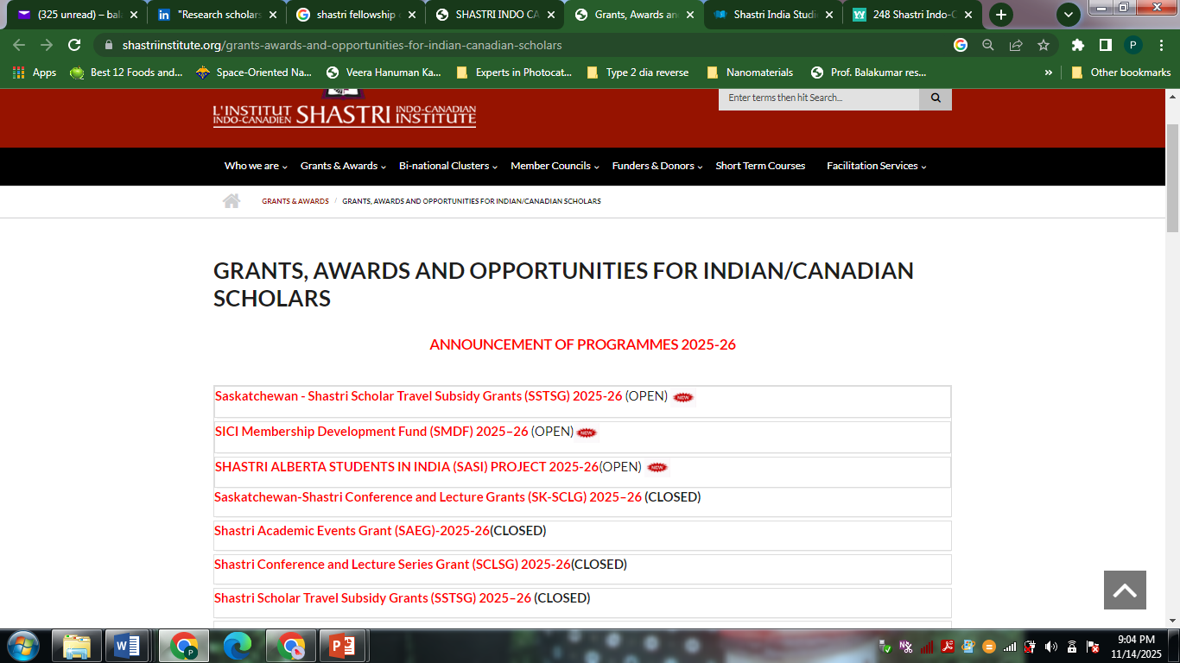

Slide 68
The Fulbright Foreign Student Program enables graduate students, young professionals, and artists from abroad to research and study in the United States for one year or longer at U.S. universities or other appropriate institutions.
PROGRAM LENGTH:6 months - 1 year
Eligibility and Application Overview
Public applications are accepted.
To participate in the Fulbright Foreign Student Program, the applicant must:
Have completed undergraduate education and hold a degree equivalent to a bachelor's degree.
Application details and grant terms for the Fulbright Program vary by country of citizenship and program. Potential applicants should consult individual country pages for program availability and contact information or see a list of current programs.
Application details and grant terms for the Fulbright Program vary by country of citizenship and program. Potential applicants should consult individual country pages for program availability and contact information or see a list of current programs.
Country-Specific Information
Details for this program may vary by country. Please select your home country or territory.
Albania
Fulbright Program Public Affairs Office U.S. Embassy Rruga Stavro Vinjau, 14 Email: TiranaUSConsulate@state.gov
https://al.usembassy.gov/education-culture/study-usa/

Slide 69
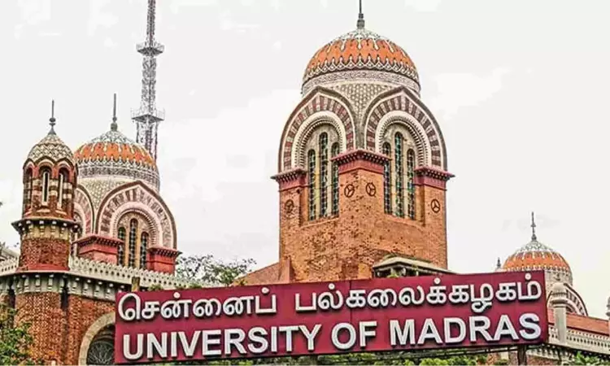

Catalyzing Excellence:
Pathways to Establishing Centres of Innovation in Science, Humanities, and Social Sciences

Slide 70

Understanding a Center of Excellence
🏢
Definition: A Center of Excellence (CoE) is a centralized unit or team focused on a specific area of expertise.
🎯
Purpose: Provides leadership, best practices, training, and support to enhance organizational performance.
💡
Core Function: Drives the adoption of new technologies, methodologies, and innovative practices.
📚
Skill Development: Improves knowledge, skills, and capabilities across teams and departments.
🚀
Innovation Hub: Acts as a platform for research, creativity, and continuous improvement.
✅
Quality Assurance: Ensures high standards, consistency, and excellence within the organization.
Strategic Role: Keeps the institution or organization at the forefront of its field through collaboration and expertise sharing.
🌍
https://aqltech.com/what-is-a-center-of-excellence-coe-its-features-benefits/

Slide 71




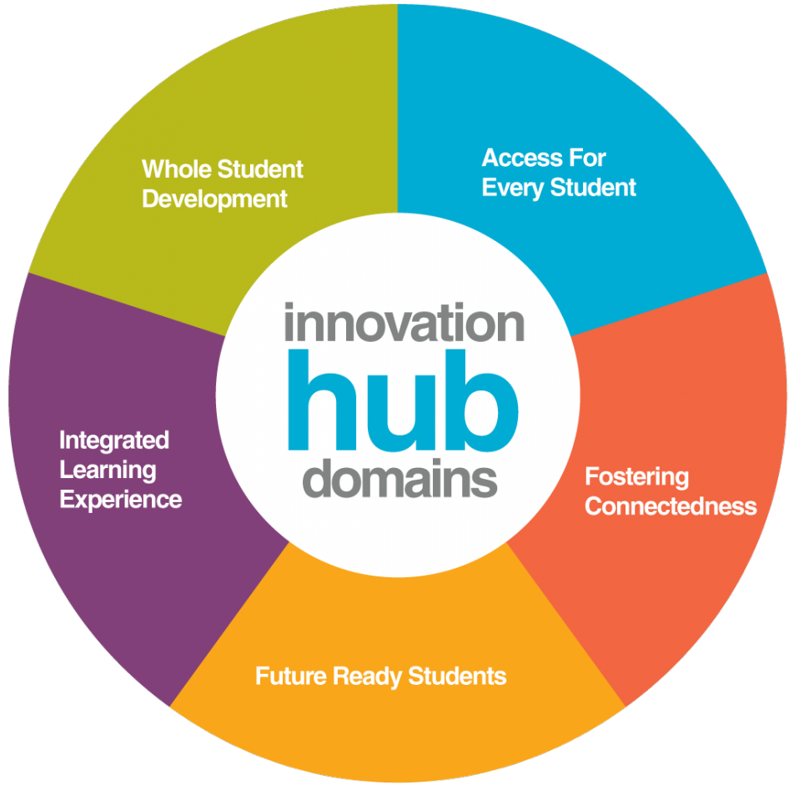
Core Features of a Center of Excellence (CoE)
1. ⚙️ Standardization
Establishes uniform processes and practices across the organization.
Ensures consistency, quality, and efficiency in project execution.
2. 📘 Best Practices Repository
Acts as a knowledge hub for proven methods, tools, and strategies.
Collects, curates, and shares best practices across all teams.
3. 🤝 Knowledge Sharing
Promotes collaboration and communication between departments.
Breaks down silos and nurtures a culture of continuous learning.
4. 🎓 Training and Development
Provides specialized training programs and upskilling opportunities.
Builds the organization’s talent base to meet strategic goals.
5. 🚀 Innovation Hub
Encourages creativity, experimentation, and new ideas.
Supports research and provides resources to bring innovations to life.

Slide 72
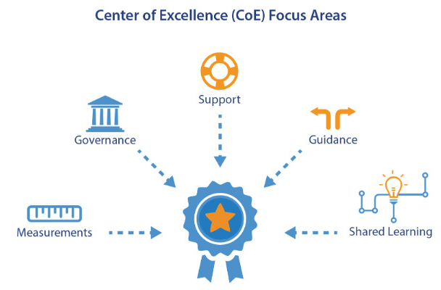

Benefits of a Center of Excellence (CoE)
⚙️ Enhanced Efficiency
Standardized processes streamline operations and reduce redundancies.
Improves overall productivity and operational flow.
✅ Improved Quality
Consistent application of best practices ensures high-quality outcomes.
Enhances organizational reputation and customer satisfaction.
💰 Cost Savings
Optimized resource utilization and process efficiency minimize waste.
Leads to measurable financial savings across projects.
⏩ Faster Time-to-Market
Standardized workflows and ready-to-use best practices speed up execution.
Enables quicker delivery of products and services.
🏆 Competitive Advantage
Continuous innovation and improvement strengthen market position.
Keeps the organization agile and responsive to industry changes.

Slide 73
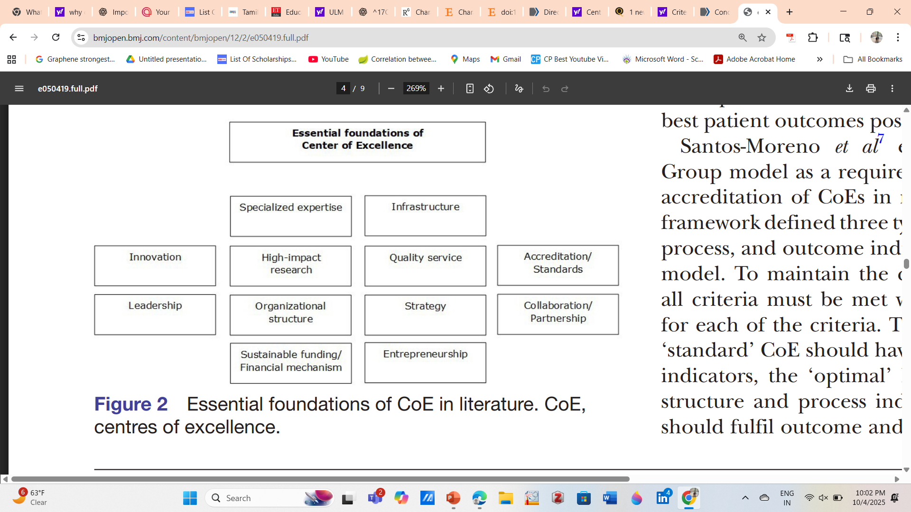
Essential foundations of a Center of Excellence
https://doi.org/10.1136/bmjopen-2021-050419

Slide 74

Funding Pathways to Establish a CoE
Government
International
Private/Industry

Slide 75
National Funding Agencies: DST, DBT, CSIR, UGC, ICSSR, ICMR, MoES, SERB
Special Programs:
“Institutions of Eminence”
National Centres of Excellence (NCoE)
Sector-specific initiatives (e.g., energy, nanoscience, AI)
Key Steps:
Proposal submission following government call
Demonstrate research excellence, infrastructure, and societal impact
Government
Multilateral Funding & Partnerships: UNESCO, EU Horizon, World Bank, WHO
Collaborative Initiatives:
Joint Centres with foreign universities
Participation in international research networks
Key Steps:
Identify alignment with global priorities
Build strong international collaborations
Apply through relevant international calls or MOUs
International
Industry-led CoEs: Tata, Reliance, Infosys, Bosch, Pfizer, GE, etc.
Public-Private Partnerships (PPP): Jointly funded labs focusing on innovation and technology translation
Key Steps:
Align research goals with industry needs
Show potential for commercialization or societal impact
Propose structured partnership model (funding + infrastructure + talent)
Private/Industry

Slide 76
Call for Proposals - DFTM invites research proposals from Academia on Research …
File for Research proposals from Academia on Research Problems for DIA-CoEs (2.58 MB)
Call for Proposals - DRDO Futuristic Technology Management (DFTM) invites research proposals from Academia on Research Problems for DIA-CoEs.
DRDO, Ministry of Defence, Govt. of India has established DRDO Industry Academia-Centre of Excellences (DIA-CoEs) at premier academic institutions and universities across the country, which function under the Corporate Clusters of DRDO, DG(TM) and DRDO Futuristic Technology Management. These centres are designed to cultivate a vibrant ecosystem for directed research through collaborative efforts involving DRDO laboratories, academia, startups, and industry partners. DIA-CoEs are focused on advancing both cutting-edge technologies and strategically defence technologies. As of now, DRDO has established 15 DIA-CoEs across the country. The research activities at these centres are organized under various thematic verticals
As of now, DRDO has established 15 DIA-CoEs across the country. The research activities at these centres are organized under various thematic verticals, which can be explored at the following link: https://lnkd.in/dSiCCpMa Interested Indian researchers from academia are encouraged to prepare proposals aligned with the thematic areas outlined in the given resources. Proposals must be submitted in the prescribed format available at the DIA-CoE website (https://lnkd.in/dKmxiyfQ) and should be sent to the Director, DRDO Futuristic Technology Management or the respective Director of DIA-CoE concerned. The link for research problems are given in https://lnkd.in/deXrXbmb DRDO, Ministry of Defence, Govt. of India has also published a Technology Foresight document detailing the projected requirements for various defence technologies, categorized by laboratory. This can be accessed at: https://lnkd.in/d5QDpZqi Share the post to enhance outreach and understanding of this initiative.

Slide 77
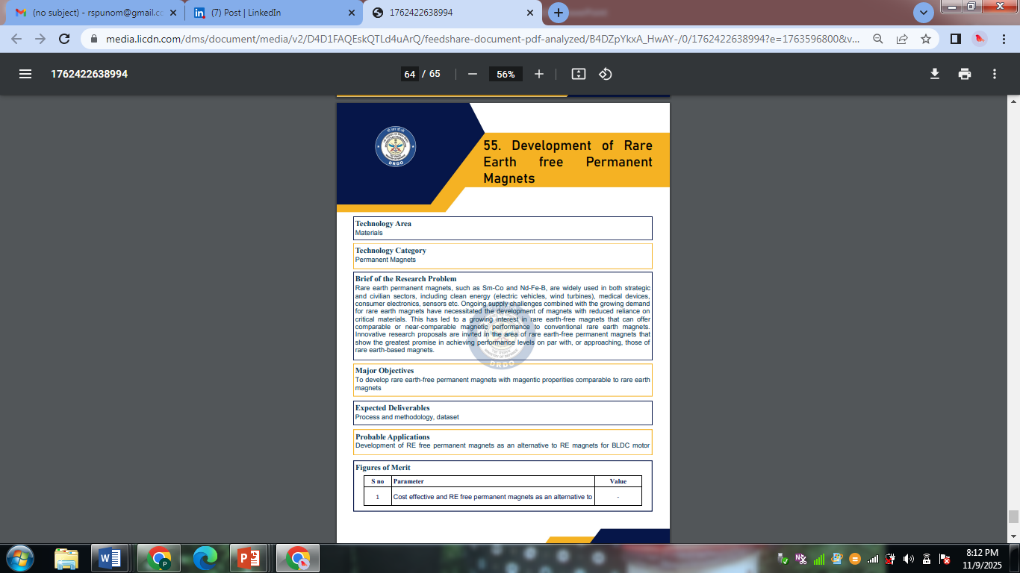

Slide 78
𝗜𝗻𝘁𝗲𝗿𝗮𝗰𝘁𝗶𝘃𝗲 𝗪𝗲𝗯𝗶𝗻𝗮𝗿 𝗼𝗻 𝗔𝗡𝗥𝗙–𝗠𝗔𝗛𝗔 𝟮𝗗 𝗠𝗮𝘁𝗲𝗿𝗶𝗮𝗹 𝗥𝗲𝘀𝗲𝗮𝗿𝗰𝗵 𝗙𝗮𝗯 𝗮𝗻𝗱 𝗜𝗻𝗻𝗼𝘃𝗮𝘁𝗶𝗼𝗻 𝗛𝘂𝗯 (𝟮𝗗 𝗜𝗻𝗻𝗼𝘃𝗮𝘁𝗶𝗼𝗻 𝗛𝘂𝗯) hashtag#ANRFIndia, in association with the Ministry of Electronics and Information Technology(MeitY), invites Consortia Proposals to establish the MAHA 2D Material Research Fab and Innovation Hub (2D Innovation Hub). The objective of the 2D Innovation Hub is to build an ecosystem for conducting scientific and industrial R&D in 2D materials-based technologies for electronic applications, focusing on design and development, capacity building, and intellectual property generation.

Slide 79


Slide 80


Government-Supported Pathways to Establish a CoE
DST (Department of Science & Technology) CoE Schemes
Focus: Basic and frontier science, technology development
Programs: NCoE, SERB-supported initiatives, thematic research clusters
Eligibility: Universities, research institutes, consortia
UGC (University Grants Commission) CoE Grants
Focus: Higher education institutions, research excellence in universities
Programs: UGC-Centre of Advanced Study (CAS), UGC-CoE Grants
Encourages interdisciplinary research and academic leadership

Slide 81


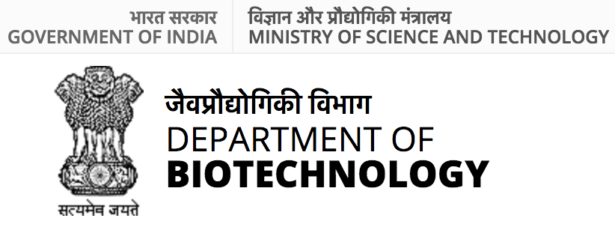
Government-Supported Pathways to Establish a CoE
ICSSR / ICHR CoEs (Humanities & Social Sciences)
Focus: Social sciences, history, culture, and humanities research
Programs: ICSSR Research Centres, HSS-focused CoEs
Promotes collaborative and applied social research
DBT / ICMR / MoES CoEs (Applied Research)
DBT: Biotechnology, life sciences, translational research
ICMR: Medical and health research excellence
MoES: Earth sciences, environmental and mineral research
Supports innovation, societal impact, and technology translation
National Missions
Skill Development Mission: CoEs to enhance vocational and technical skills
Critical Minerals Mission: Centres focusing on sustainable exploration and utilization of minerals

Slide 82


Steps to Establish a CoE
Identify niche or interdisciplinary research area
2. Prepare a strong research and collaboration proposal
3. Secure funding from government, international, or private sources
4. Build infrastructure and recruit faculty/students
5. Establish governance, monitoring, and sustainability plan

Slide 83

Challenges and Solution in the path of CoE
Funding Constraints → Multi-Source Funding Strategy
Challenge:Limited budget can slow research, infrastructure, and program development.
Solution: Combine government grants, industry partnerships, international funding, and philanthropy to ensure stable financial support.
Faculty Retention → Incentives & Research Environment
Challenge: Talented faculty may leave for better opportunities elsewhere.
Solution: Offer competitive salaries, sabbatical programs, professional growth opportunities, and a collaborative research culture to enhance job satisfaction and loyalty.
Collaboration → MoUs & Formal Networks
Challenge: Lack of strong partnerships can restrict interdisciplinary and international projects.
Solution: Establish Memoranda of Understanding (MoUs), participate in formal research networks, and create exchange programs to strengthen collaboration.

Slide 84


Excellence in a university is a collective journey, driven by teaching, research, and collaboration.
Vision Realized
Strategic Pathways
Faculty & Student Empowerment
Collaborative Networks
Call to Action
Excellence is not accidental; it is cultivated through vision, strategy, and collaboration.. Together WE CAN!!!
Notes:
Vision Realized – Establishing Centres of Innovation strengthens research, teaching, and societal impact across science, humanities, and social sciences.
Strategic Pathways – Leveraging government schemes, international collaborations, and multi-source funding ensures sustainability and excellence.
Faculty & Student Empowerment – Supporting talent through incentives, mentorship, and exchange programs fosters innovation and long-term retention.
Collaborative Networks – MoUs, partnerships, and interdisciplinary initiatives accelerate knowledge creation and global competitiveness.
Call to Action – By strategically navigating funding, partnerships, and talent management, institutions can transform ideas into tangible societal and academic impact.

